Slide 1
MIS 7720 #13 Natural Language Processing

Slide 2
Overview
Natural Language processing (NLP) deals with how to process and analyze large amounts of natural language data.
Neural networks have been successfully used to address various problems in NLP
https://devopedia.org/neural-networks-for-nlp
Selection of topics on dealing with textual data
Text preprocessing
Classifying documents
Sentiment analysis
Topic Modeling
Text summarization
Dialogue systems, Chatbots
Notes:
Before machine learning approaches for NLP, rule-based NLP system were used that consist of hand-coded set of rules (these system were not very successful).

Slide 3
Common Terms
Document: a piece of text, often the level of analysis;
Corpus: a collection of documents;
Word token: a single word.
Vocabulary: collection of all unique word tokens in a corpus.
Word Vector: mathematical representation of a Document
Notes:
Some terminology before we get started working with textual data

Slide 4
Pre-processing steps
Tokenize each document; identify all the individual words in each document.
Make a vocabulary list that includes all the words in all the documents (the bag of words approach).
Remove stop words (neutral words like: is, and, the, as, etc.)
Lemmatize and/or stem words:
Lemmatize – replace “ing”, “ed”, “es”, etc with its (dictionary) root word (buses -> bus)
Stemming – remove word endings (trains -> train but beautifully ->beauti)
Count what words appear in each document (TF, IDF)
Notes:
ML/AI algorithms cannot process text as we do. We need to first process the text and change it into a mathematical representation that is more machine friendly.
The first step is pre-processing textual data.

Slide 5
Pre-processing: Tokenization
Tokenize each document (here, each sentence is a document)
“Hello, welcome to the party.”
“This party is awesome!”
“Welcome to Lisa’s birthday party.”
Tokenization, lower-casing
“hello”, “welcome”, “to”, “the”, “party”
“this”, “party” “is” “awesome”
“welcome”, “to”, “lisa’s”, “birthday”, “party”

Slide 6
Remove stop words, Lemmatize, Stem
Neutral words such as: is, and, the, as, etc.
Lemmatize or stem words:
Lemmatize – replace “ing”, “ed”, “es”, etc with its (dictionary) root word (buses -> bus)
Stemming – remove word endings (trains -> train but beautifully ->beauti)
“hello”, “welcome”, “party”
“party” , “awesome”
“welcome”, “lisa”, “birthday”, “party”
Notes:
Sample stop word lists:
https://www.ranks.nl/stopwords
https://gist.github.com/sebleier/554280
http://snowball.tartarus.org/algorithms/english/stop.txt

Slide 7
Term frequency (TF)
Count what words appear in each document
“hello”, “welcome”, “party”
“party” , “awesome”
“welcome”, “lisa”, “birthday”, “party”
Term frequency (TF)
 | hello | welcome | party | lisa | awesome | birthday
1 | 1 | 1 | 1 | 0 | 0 | 0
2 | 0 | 0 | 1 | 0 | 1 | 0
3 | 0 | 1 | 1 | 1 | 0 | 1

Slide 8
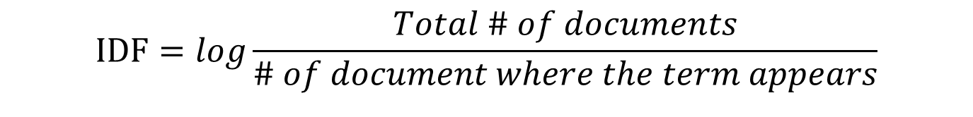
Inverse document frequency (IDF)
Indicates how important a word is to a document in a collection or corpus.
$$IDF=log\frac{Total \# of documents}{\# of document where the term appears}$$
 | hello | welcome | party | lisa | awesome | birthday
1 | 1 | 1 | 1 | 0 | 0 | 0
2 | 0 | 0 | 1 | 0 | 1 | 0
3 | 0 | 1 | 1 | 1 | 0 | 1
IDF(“welcome”)=log(3/2)=1.18
IDF(“party”) = log(3/3) = 0
IDF(“Lisa”) = log(3/1) = 0.48
TF-IDF = TF*IDF
 | hello | welcome | party | lisa | awesome | birthday
1 | 0.48 | 1.18 | 0 | 0 | 0 | 0
2 | 0 | 0 | 0 | 0 | 0.48 | 0
3 | 0 | 1.18 | 0 | 0.48 | 0 | 0.48

Slide 9
Additional pre-processing steps
Generate n-grams: “phd”+”brownbag”→”phd brownbag”
Feature pruning: remove too frequent or too rare word features.
Normalization: normalizing TF-IDF score, some implementations does this as a subroutine of TF-IDF.

Slide 10
General Process of Text Analytics
Raw data
Specifically important for text/image data
Feature Construction
Feature Selection
Model building
Model deployment / interpretation
Model evaluation

Slide 11
Topic Modeling
Topic Modeling:
Finding underlying semantic “themes” as topics;
Exploratory/unsupervised learning – no “right” answer, subject to interpretation;
A prevalent approach – Latent Dirichlet Allocation (LDA)
LDA and document clustering:
LDA is conceptually similar to soft clustering;
Output of LDA can be input for clustering.

Slide 12
Topic Modeling with LDA
LDA (Blei 2012)
In plain (but not rigorous) language:
User specifies the number of topics (K) to look for;
Each document is a mixture of all K topics with certain proportions
Each topic is a mixture of all words in vocabulary with certain proportions
In more rigorous language:
User specifies the number of topics (K) to look for;
Each document is a multinomial distribution over all topics;
Each topic is a multinomial distribution over vocabulary.
Notes:
http://www.cs.columbia.edu/~blei/papers/Blei2012.pdf

Slide 13
Topic Modeling with LDA
Where is “Dirichlet” in the process?
Parameters of multinomial distributions are drawn from two Dirichlet distributions.
Why Dirichlet – computational simplicity (details here).
What does LDA output?
Distribution of each topic over vocabulary
Distribution of each document over topics
What can we use LDA for?
Describe how topically “focused” a document is (Abhishek et al. 2014).
Measure entity similarity (Shi et al. 2015).
Quantifies information diversity (Wu 2013).
Notes:
Dirichlet distribution is the conjugate prior to multinomial distribution.

Slide 14
Text Feature Construction: Word Embedding Approach
Limitations of Bag-of-word approach:
Little information about relations between words.
Sparse representation of document.
How to capture contextual information?
Assumption: words that appear in the same context tend to have similar semantic meaning.
Example: “cat jumps” & “dog jumps” → “cat” is similar to “dog” because they both precede the word “jumps”.

Slide 15
Word Embedding Approach
Word embedding approach:
Vector representation of a word (K numbers describe one word) that captures the context of the word (e.g., semantic information) in a document.
Deriving word embeddings is an unsupervised learning process:
User specify the dimension of embedding (i.e., K)
Learned via huge amount of raw text (~billions)
Different ways to learn word embedding:
Word2vec (Google), GloVe (Stanford), …

Slide 16
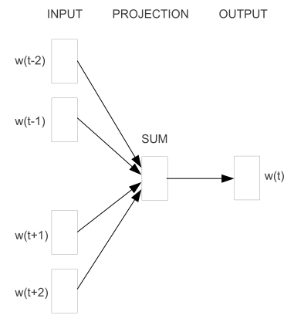
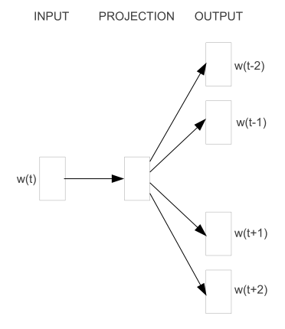
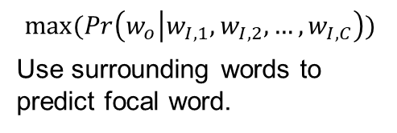
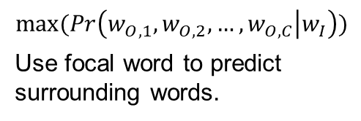
Word2vec (Mikolov 2013) at Google
Continuous Bag-of-Word (CWOB)
Skip-gram
Is a 2- layer neural network process for vectorizing words.
Word2vec transforms text into a numerical form that we can feed into deep NN models, such as RNN.
$$max⁡(\operatorname{Pr}\left(w_{o} | w_{I,1},w_{I,2},…,w_{I,C}\right))$$
Use surrounding words to predict focal word.
$$max⁡(\operatorname{Pr}\left(w_{O,1},w_{O,2},…,w_{O,C} | w_{I}\right))$$
Use focal word to predict surrounding words.
Notes:
https://arxiv.org/abs/1301.3781

Slide 17
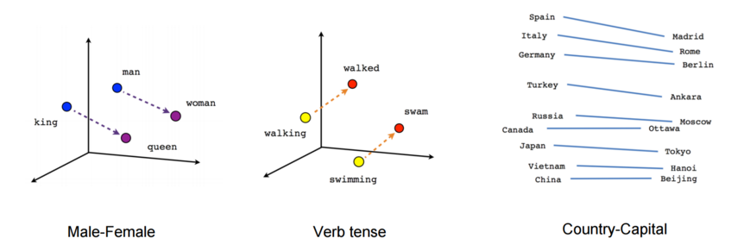
Word2vec
Evaluate word embedding – semantic task
Two words are similar if they have small cosine distance.
Words analogy: “A is to B what C is to D”.
Visualization of word embedding (t-SNE)

Slide 18
Word2vec
What can we use word2vec for?
Predictive and exploratory models
Aggregate word embedding to form document-level features.
Word2vec using python: “gensim” package
Advantage:
Simple to use
Trained word2vec model can be easily stored and retrieved
Supports online training
A tutorial is here

Slide 19
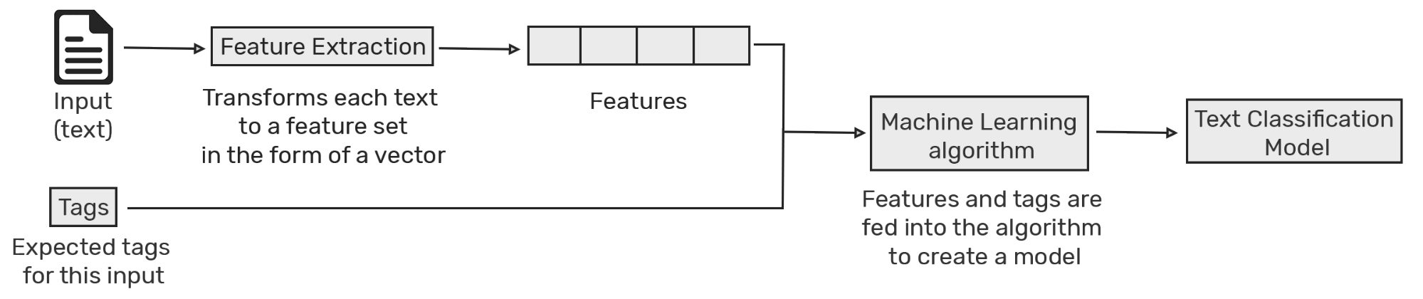
Text Classification
Classifying documents (textual data) to predefined categories
We use the extracted features from the preprocessing steps
BOW or Word embedding approaches
The rest of the process is similar to training classifiers
Non NN
Naïve Bayes
K-NN
SVM
Deep NN
RNN+LSTM/GRU
Certain CNNs

Slide 20
Text Classification applications
Sentiment analysis: outcome is “sentiment”
Positive
Negative
Language Detection
Content Tagging
E-commerce, news agencies, content curation, …
Marketing
…any context where automatic classification of textual data is helpful
Notes:
Sentiment analysis using neural networks (with python code):
https://towardsdatascience.com/another-twitter-sentiment-analysis-with-python-part-10-neural-network-with-a6441269aa3c

Slide 21
Text summarization
80% of big data is in the form of text
Extractive Summarization:
Identifying important sections of the text and generating them verbatim producing a subset of the sentences from the original text.
Identifying the right sentences for summarization is of utmost importance in an extractive method.
Abstractive Summarization
Reproduces important material in a new way after interpretation and examination of the text using advanced natural language techniques to generate a new shorter text that conveys the most critical information from the original one.
Some parts of this summary may not even appear in the original text.
Notes:
https://medium.com/sciforce/towards-automatic-text-summarization-extractive-methods-e8439cd54715
https://medium.com/sciforce/towards-automatic-summarization-part-2-abstractive-methods-c424386a65ea
https://en.wikipedia.org/wiki/Automatic_summarization

Slide 22
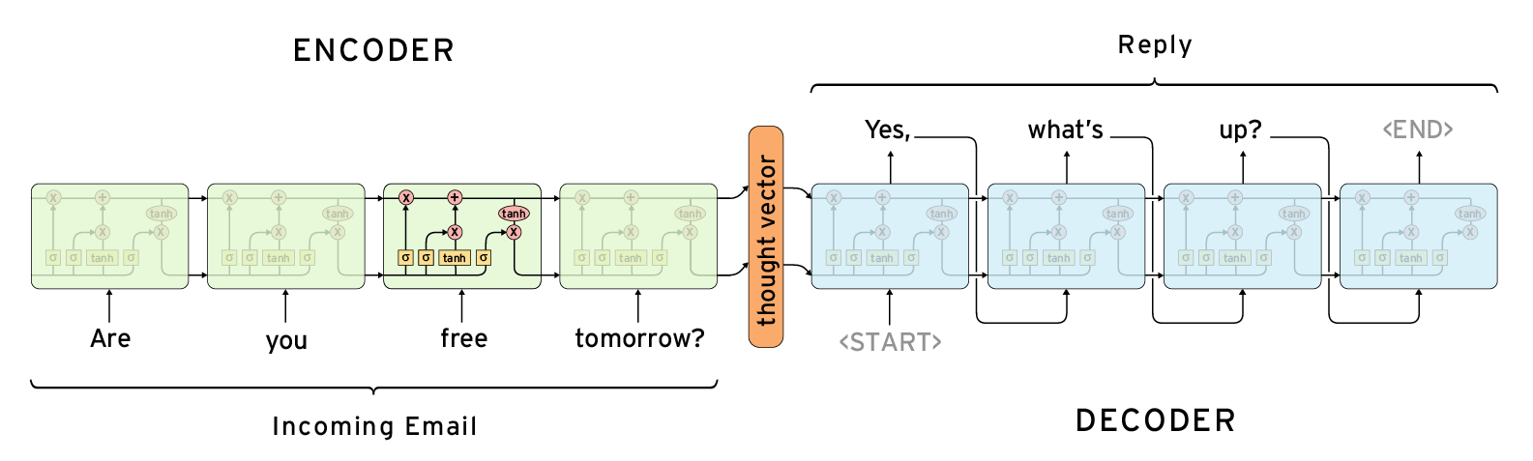
Text summarization
TextRank algorithm: Finds how similar each sentence is to all other sentences in the text. The most important sentence is the one that is most similar to all the others
Gensim.summarization, Pytextrank
Sequence-to-Sequence models
Using 2 sets of Deep RNNs
Notes:
https://www.aclweb.org/anthology/W04-3252
Seq 2 Seq models:
https://ai.googleblog.com/2016/08/text-summarization-with-tensorflow.html
https://github.com/thunlp/TensorFlow-Summarization
https://github.com/tensorflow/models/tree/master/research/textsum

Slide 23
More Resources
A Brief Survey of Text Mining: Classification, Clustering and Extraction Techniques
https://arxiv.org/pdf/1707.02919.pdf

Slide 24
Dialogue systems
Task-oriented systems
Aim to assist users complete a certain task
Involves hand crafted If-Then rules (still use NNs to understand language)
Non-task-oriented systems (aka chat-bots) – use deep NN
Focus on conversing with humans
Generative methods: better at responding to unseen dialogue
Retrieval-based methods: more fluent but may lack answers
Notes:
A Survey on Dialogue Systems: https://arxiv.org/pdf/1711.01731.pdf
Today’s approach largely based on Neural Conversational models. See https://arxiv.org/abs/1506.05869

Slide 25
Dialogue systems
Dialogue data (labeled data for model training) samples
https://breakend.github.io/DialogDatasets/
Support call conversations
Movie transcripts
Business applications
Customer service, Sales, Marketing, E-commerce, IT helpdesk, …
Chatbots as a service
Google https://dialogflow.com/
Amazon https://aws.amazon.com/chatbot/
Several other firms/startups providing chatbots
Try a chat with Mitsuku at https://www.pandorabots.com/mitsuku/

Slide 26
State of the art for NLP
BERT- Bidirectional Encoder Representations from Transformers
can be used for several NLP tasks including summarization
https://github.com/google-research/bert
https://arxiv.org/abs/1810.04805
Chatbots
Google Meena https://arxiv.org/abs/2001.09977
https://ai.googleblog.com/2020/01/towards-conversational-agent-that-can.html

Slide 27
Hands-on activities
We will have several activities for this part:
Topic modeling
Text classification / sentiment analysis
Text summarization
Topic modeling using BERT
Details will be posted on elearn.

